Slide 1
Regression Analysis
Regression Analysis in Practice
Nicoleta Serban, Ph.D.
Professor
School of Industrial and Systems Engineering
Predicting Customer Churn

Slide 2

About This Lesson

Slide 3
Prediction
## Using the full model
pred.full = predict(full.model.red, newdata =
test.reduced, type = "response")
## Using the model from stepwise selection
## Variables not selected : Gender, Senior Citizen, Online Backup and Device Protection
pred.step = predict(step.model, newdata =
test.reduced, type = "response")
## Using the model from LASSO
## Variables not selected : Online Backup and Payment Method
pred.lasso = predict(lasso.retrained, newdata =
as.data.frame(new_test), type = "response")
## Using the model from Elastic Net (All selected)
pred.elnet = as.vector(predict(elnet.model, newx =
x.test, type = "response", s = cv.elnet$lambda.min))
Use classification threshold = 0.5
Predicted churn probability < 0.5 => Churn prediction = 0
Predicted churn probability > 0.5 => Churn prediction = 1

Slide 4
Prediction (cont’d)
## Using the full model
pred.full = predict(full.model.red, newdata =
test.reduced, type = "response")
## Using the model from stepwise selection
## Variables not selected : Gender, Senior Citizen, Online Backup and Device Protection
pred.step = predict(step.model, newdata =
test.reduced, type = "response")
## Using the model from LASSO
## Variables not selected : Online Backup and Payment Method
pred.lasso = predict(lasso.retrained, newdata =
as.data.frame(new_test), type = "response")
## Using the model from Elastic Net (All selected)
pred.elnet = as.vector(predict(elnet.model, newx =
x.test, type = "response", s = cv.elnet$lambda.min))
Prediction Output
Customers in Test Data | Actual Churn Value | predClass. full | predClass. step | predClas. lasso | predClass. elnet
6 | 0 | 0 | 0 | 0 | 0
122 | 1 | 0 | 0 | 0 | 0
139 | 0 | 0 | 0 | 0 | 0
257 | 0 | 0 | 0 | 0 | 0
522 | 0 | 0 | 0 | 0 | 0
594 | 1 | 1 | 1 | 1 | 1
733 | 0 | 0 | 0 | 0 | 0
951 | 0 | 0 | 0 | 0 | 0
982 | 1 | 0 | 0 | 0 | 0
1078 | 0 | 0 | 0 | 0 | 0
1091 | 0 | 0 | 0 | 0 | 0
1094 | 0 | 1 | 1 | 1 | 1
1123 | 0 | 0 | 0 | 0 | 0
1161 | 1 | 0 | 0 | 0 | 0
1249 | 0 | 0 | 0 | 0 | 0
1429 | 0 | 0 | 0 | 0 | 0
Use classification threshold = 0.5
Predicted churn probability < 0.5 => Churn prediction = 0
Predicted churn probability > 0.5 => Churn prediction = 1

Slide 5
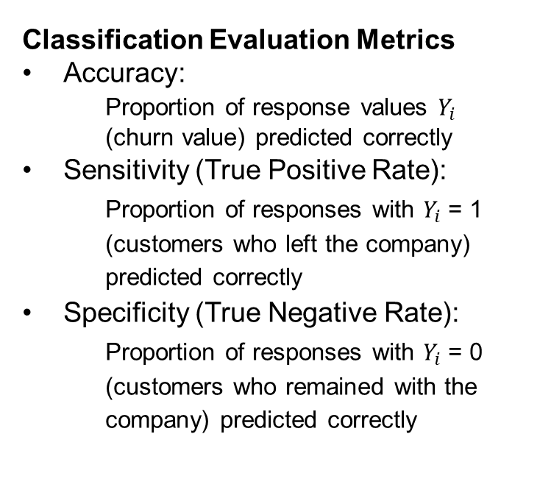
Classification Accuracy
Classification Evaluation Metrics
Accuracy:
Proportion of response values $Y_{i}$ (churn value) predicted correctly
Sensitivity (True Positive Rate):
Proportion of responses with $Y_{i}$ = 1 (customers who left the company) predicted correctly
Specificity (True Negative Rate):
  Proportion of responses with $Y_{i}$ = 0 (customers who remained with the company) predicted correctly
 | Person who left the company | Person who remained with the company
Classified as churned | True Positive | False Positive
Classified as not churned | False Negative | True Negative

Slide 6
Model Comparison via Classification Evaluation Metrics
## Calculate the Accuracy, the Sensitivity and the Specificity metrics to evaluate these models at 0.5 threshold
pred_metrics = function(modelName, actualClass, predClass) {
cat(modelName, '\n')
conmat <- confusionMatrix(table(actualClass, predClass))
c(conmat$overall["Accuracy"], conmat$byClass["Sensitivity"],
conmat$byClass["Specificity"])
}
##Full model
pred_metrics("Full Model",test$Churn.Value, predClass.full)
##Stepwise selection model
pred_metrics("Stepwise Regression Model",test$Churn.Value, predClass.step)
##Lasso model
pred_metrics("Lasso Regression Model",test$Churn.Value, predClass.lasso)
##Elastic Net model
pred_metrics("Elastic Regression Model",test$Churn.Value, predClass.elnet)

Slide 7
Model Comparison via Classification Evaluation Metrics
Full Model
Accuracy | Sensitivity | Specificity
0.8180 | 0.8577 | 0.6832
Threshold value: 0.5
All models have very similar prediction metrics. In this case, correctly identifying positives is more important for us. Therefore, we should choose a model with higher Sensitivity.
Stepwise Regression Model
Accuracy | Sensitivity | Specificity
0.8174 | 0.8582 | 0.6807
Lasso Regression Model
Accuracy | Sensitivity | Specificity
0.8168 | 0.8576 | 0.6799

Slide 8
Classification Evaluation Metrics: Different Threshold
Full Model
Accuracy | Sensitivity | Specificity
0.7742 | 0.9116 | 0.5521
Threshold value: 0.3
All models have very similar prediction metrics. Sensitivity has improved while the specificity has decreased as well as the overall accuracy.
Stepwise Regression Model
Accuracy | Sensitivity | Specificity
0.7776 | 0.9136 | 0.5567
Lasso Regression Model
Accuracy | Sensitivity | Specificity
0.7759 | 0.9111 | 0.5547

Slide 9
Goodness of fit
## Measure how well the Logistic Regression model (after variable selection through Stepwise Selection) fits on the training data
# Removing variables not selected by stepwise regression
step.predictors <- names(coef(full.model.red)[index.step])
x.train <- as.data.frame(x.train)
train.final <- x.train[, - which(colnames(x.train) %in% step.predictors)]
# Aggregating the data
obdata.agg.n = aggregate(y.train ~ . , data = train.final, FUN = length)
obdata.agg.y = aggregate(y.train ~ . , data = train.final, FUN = sum)
dat.aggr <- cbind(obdata.agg.y, total = obdata.agg.n$y.train)
## Fitting the model
mod.aggr = glm(y.train / total ~ . , data = dat.aggr, weight = total, family = binomial)
summary(mod.aggr)

Slide 10
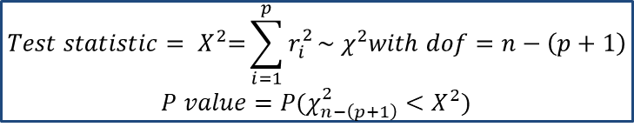
Goodness of fit (cont’d)
# Find the Chi-square test statistics and the corresponding p-value to test the given null hypothesis.
res = resid(mod.aggr, type="deviance")
cbind(statistic = sum(res^2), pvalue = 1-pchisq(sum(res^2), mod.aggr$df.resid))
$$Test statistic= X^{2}\text{=}\sum_{i=1}^{p}{r_{i}^{2}}\sim χ^{2}with dof=n−\left(p+1\right)$$
$$P value=P(χ_{n−\left(p+1\right)}^{2}<X^{2})$$
Chi-Square Test Statistics | P-value
4180.503 | 1
P-value is equal to 1, so our model reasonably fits the training data.

Slide 11
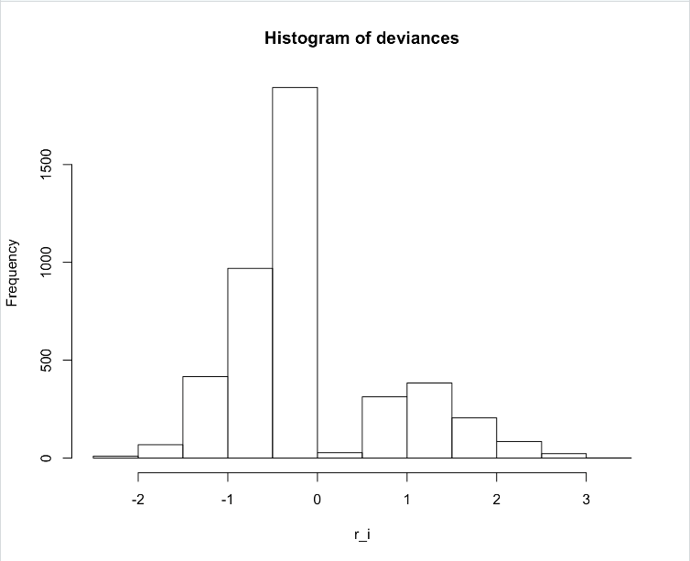
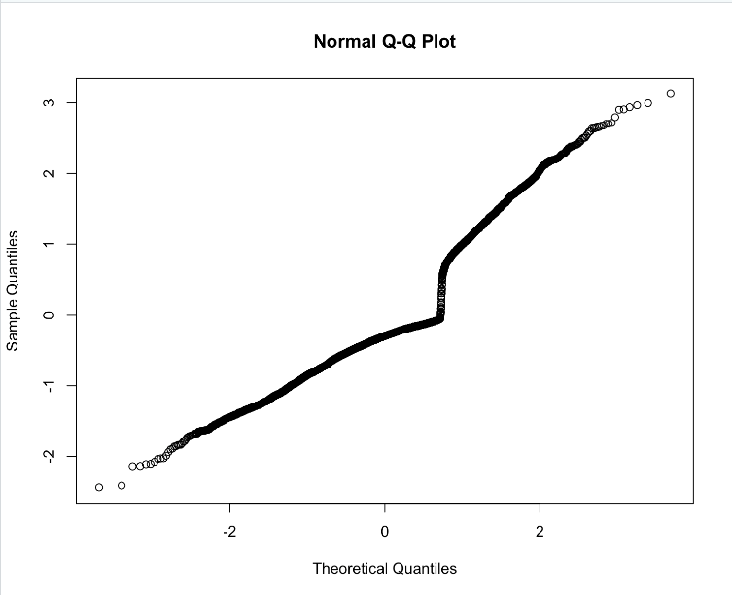
Goodness of fit (cont’d)
# Checking the normality of deviance residuals assumption
hist(res, main="Histogram of deviances",breaks = 8,xlab = "r_i")
qqnorm(res)
Normality assumption seems to be violated due to bi-modality in the data.

Slide 12

Summary

